Slide 1

HOTEL RESERVATION ANALYSIS with sql
task 2:
Name: Precious onyedeke
Batch: MIP-DA-08

Slide 2
Overview
The hotel industry relies on data to make informed decisions and provide a better guest experience. In this internship, you will work with a hotel reservation dataset to gain insights into guest preferences, booking trends, and other key factors that impact the hotel's operations. You will use SQL to query and analyze the data, as well as answer specific questions about the dataset.

Slide 3
Dataset Details
The dataset includes the following columns:
Booking_ID: A unique identifier for each hotel reservation.
No_of_Adults: The number of adults in the reservation.
No_of_Children: The number of children in the reservation.
No_of_Weekend_Nights: The number of nights in the reservation that fall on weekends.
No_of_Week_Nights: The number of nights in the reservation that fall on
weekdays.

Slide 4
Dataset Details
Type_of_Meal_Plan: The meal plan chosen by the guests.
Room_Type_Reserved: The type of room reserved by the guests.
Lead_Time: The number of days between booking and arrival.
Arrival_Date: The date of arrival.
Market_Segment_Type: The market segment to which the reservation
belongs.
Avg_Price_Per_Room: The average price per room in the reservation.
Booking_Status: The status of the booking.

Slide 5
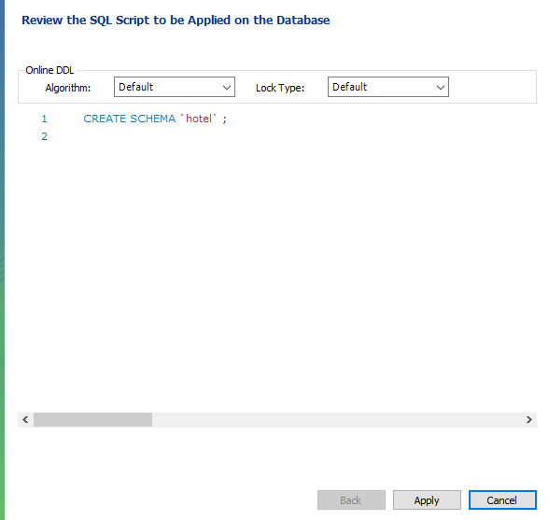
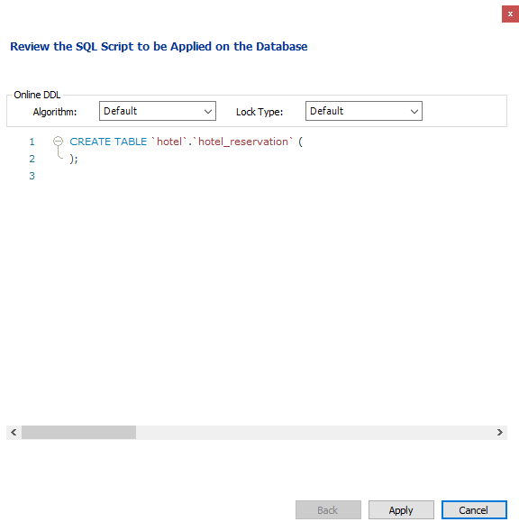
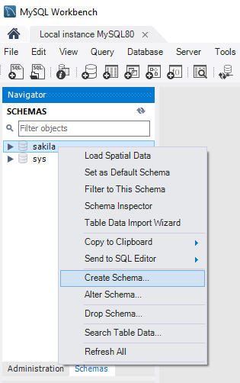
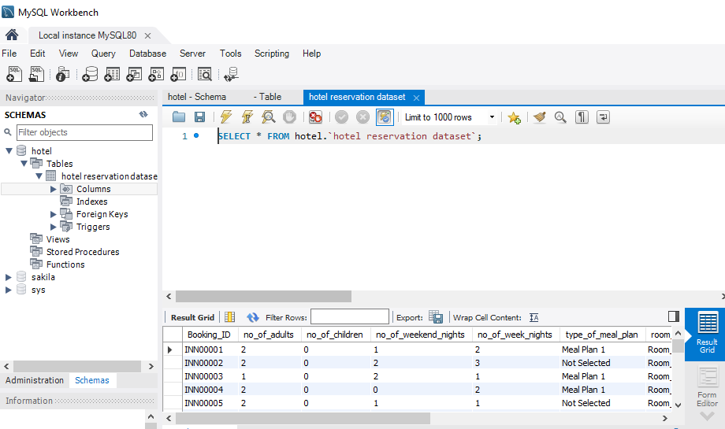
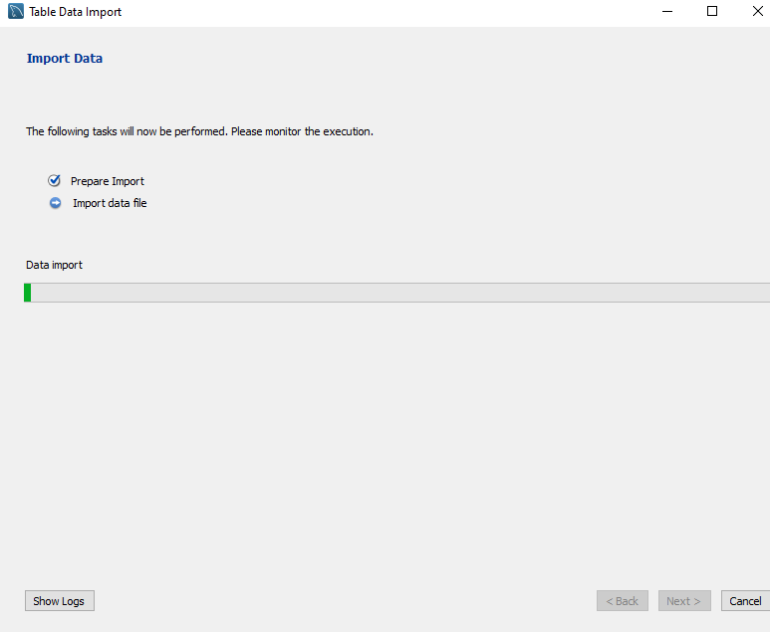
Data import and table creation in sql

Slide 6
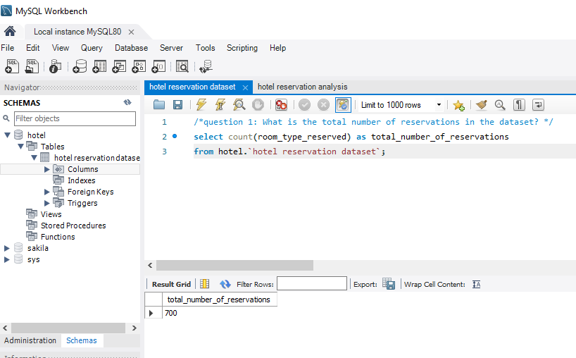
What is the total number of reservations in the dataset?
The total number of reservations is 700

Slide 7
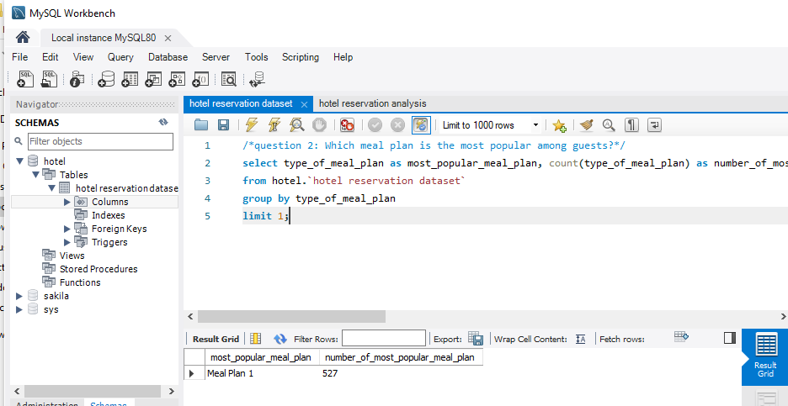
Which meal plan is the most popular among guests?
The most popular meal plan is meal plan 1

Slide 8
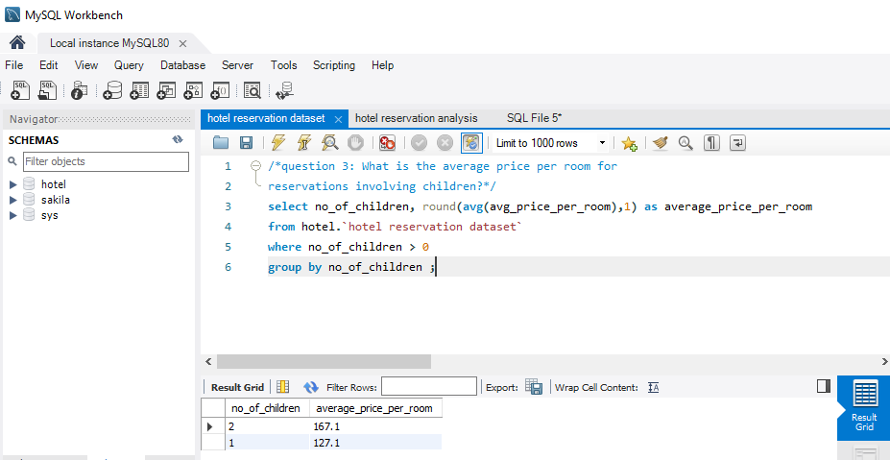
What is the average price per room for reservations involving children?
The average price per room involving children are:
Number of child 1: 127.1
Number of child 2: 167.1
This shows that the price per room for 2 children is greater than the price per room for one child.

Slide 9
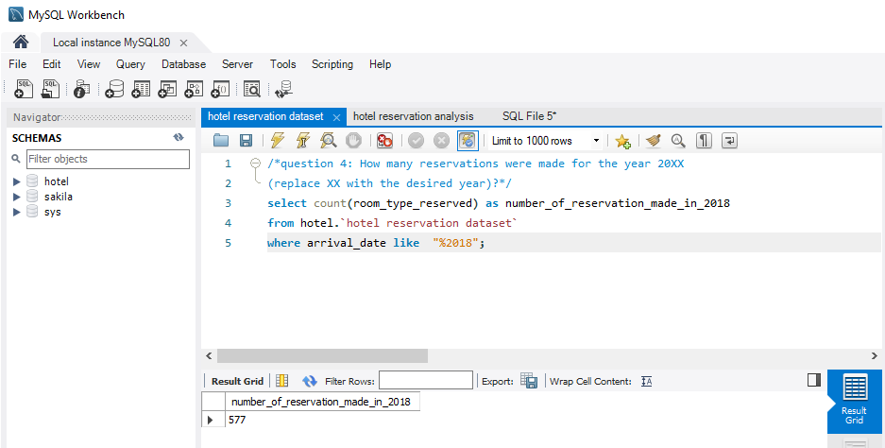
How many reservations were made for the year 2018?
The number of reservations made in 2018 is 577

Slide 10
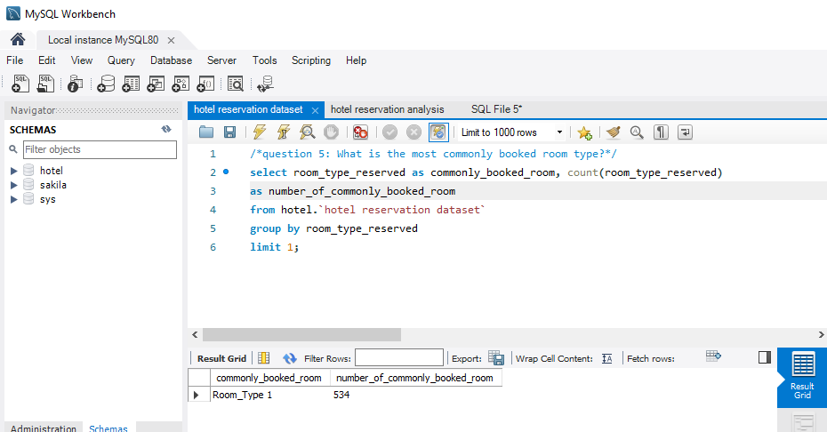
What is the most commonly booked room type?
The most commonly booked room is room type 1 with 534 bookings

Slide 11
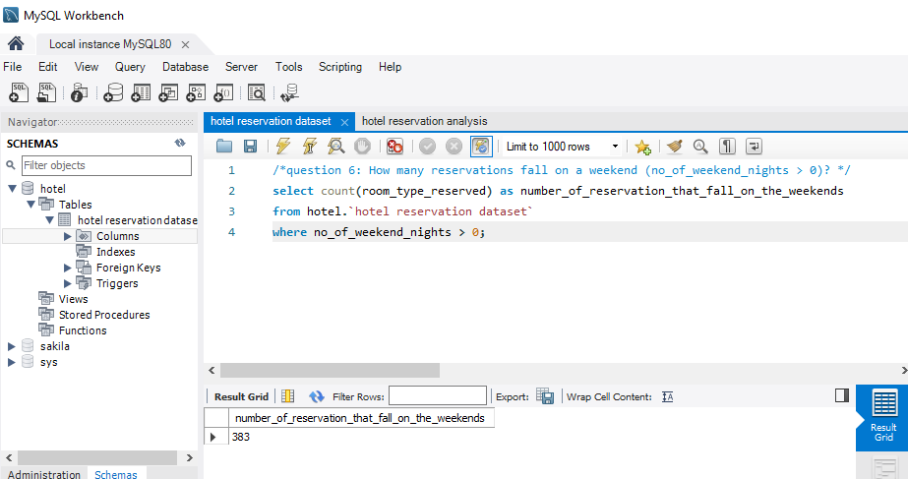
How many reservations fall on a weekend (no_of_weekend_nights > 0)?
383 number of reservations fall on the weekends

Slide 12
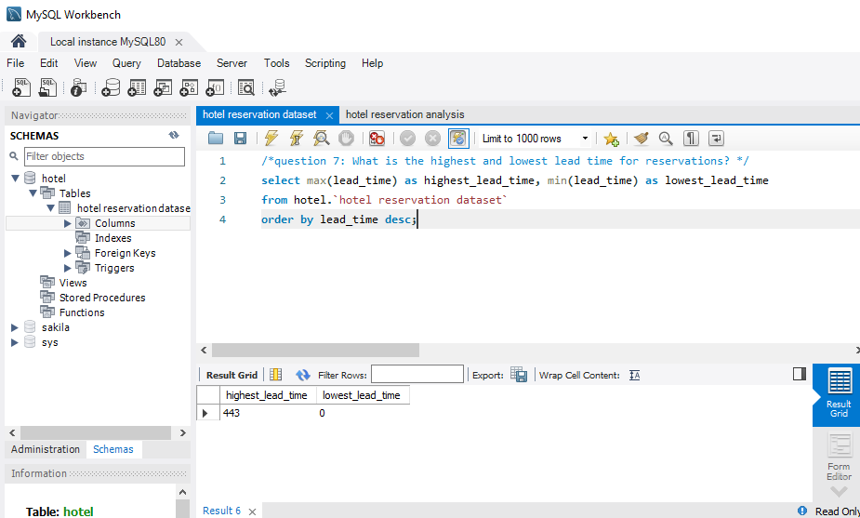
What is the highest and lowest lead time for reservations?
The highest lead time is 443, the lowest lead time is 0

Slide 13
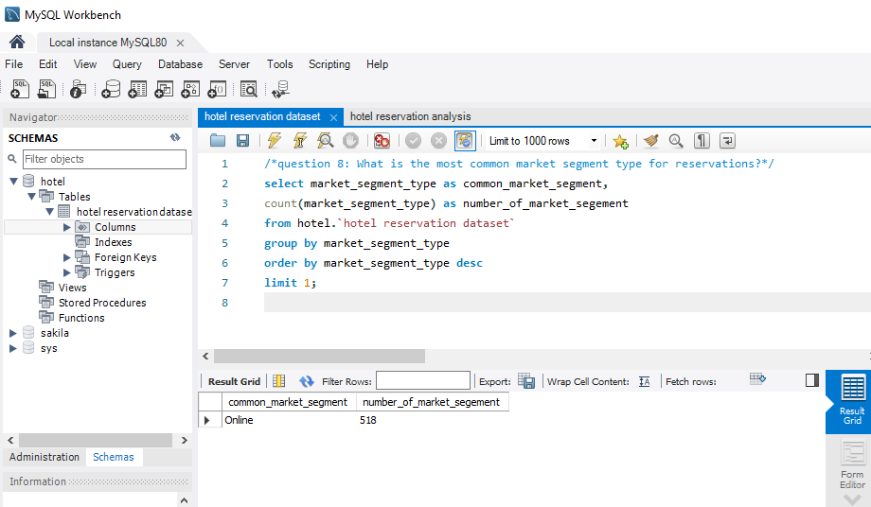
What is the most common market segment type for reservations?
The most common market segment is online with 518 number of market segment

Slide 14
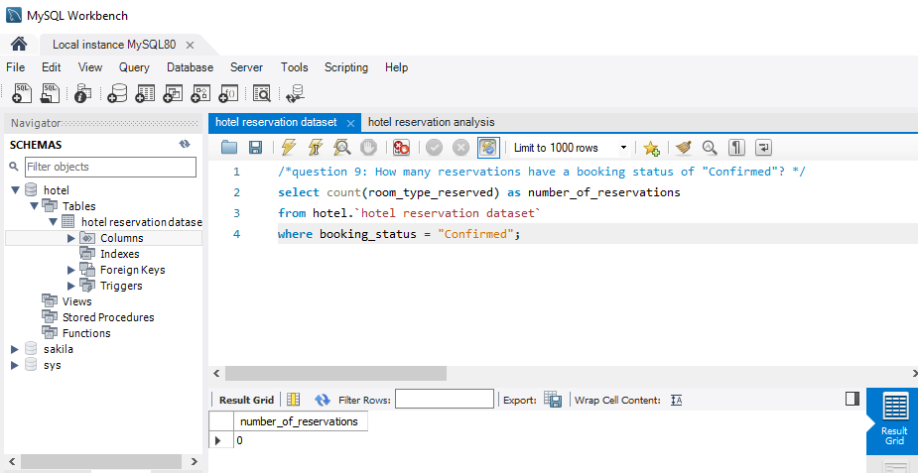
How many reservations have a booking status of "Confirmed"?
There is no reservation with the booking status “confirmed”

Slide 15
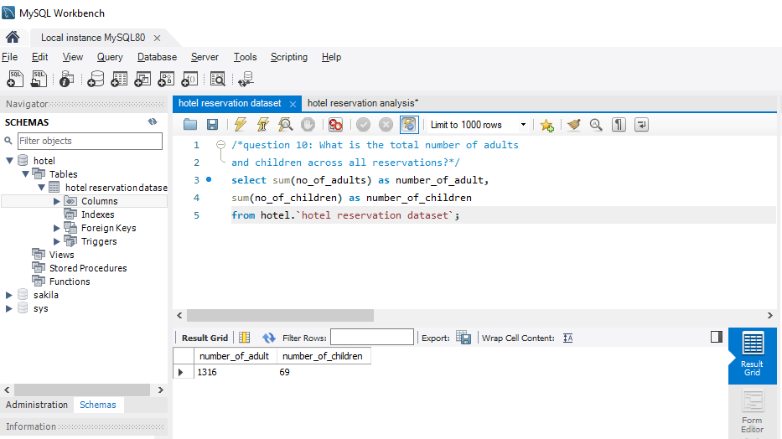
What is the total number of adults and children across all reservations?
The total number of adults and children across all reservations is 1316 and 69

Slide 16
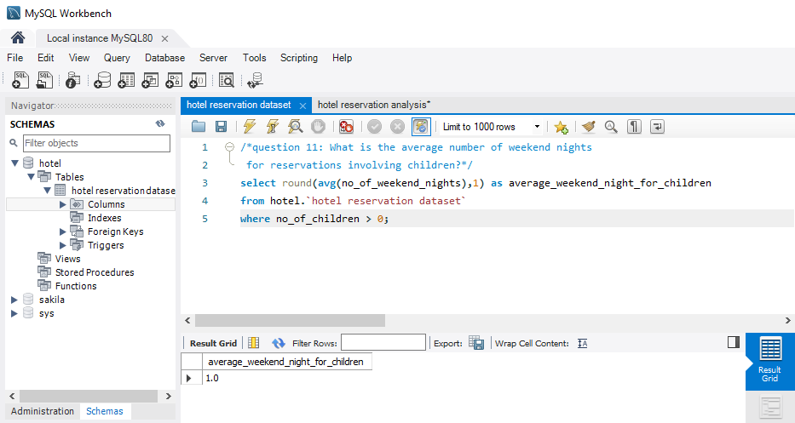
What is the average number of weekend nights for reservations involving children?
The average weekend night for children is 1.0

Slide 17
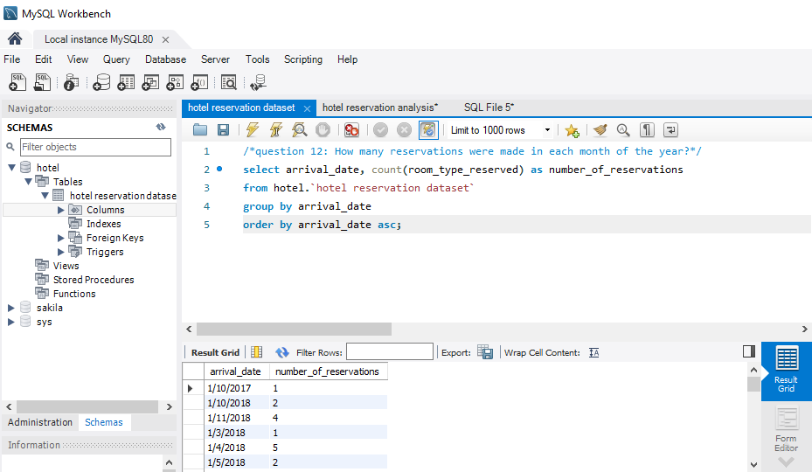
How many reservations were made in each month of the year?

Slide 18
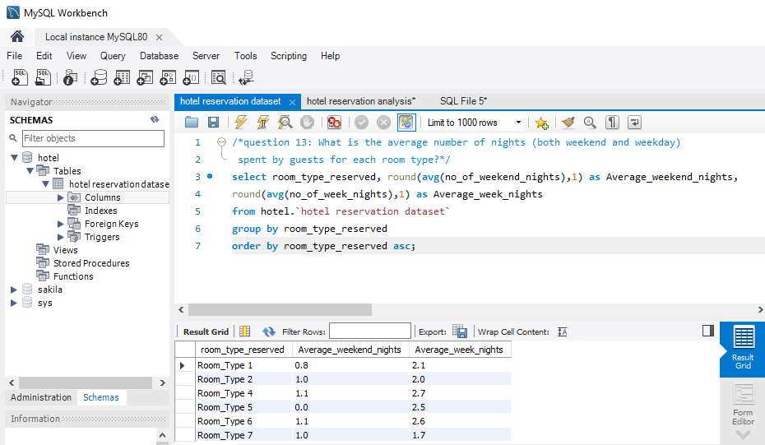
What is the average number of nights (both weekend and weekday) spent by guests for each room type?

Slide 19
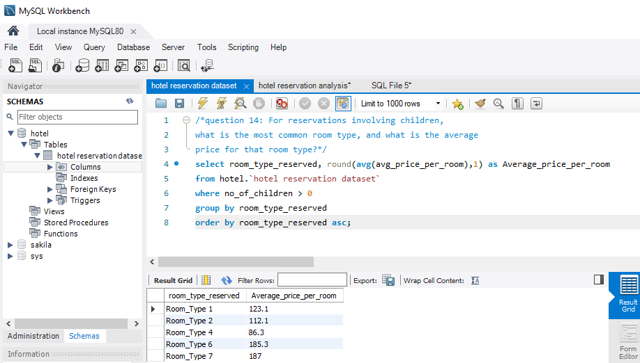
For reservations involving children, what is the most common room type, and what is the average price for that room type?

Slide 20
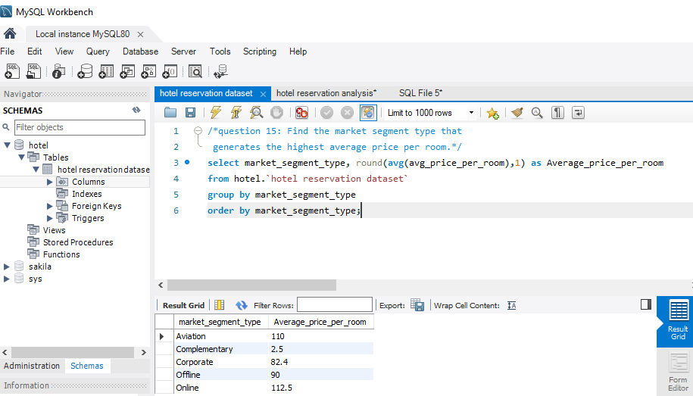
Find the market segment type that generates the highest average price per room.
The market segment that generates the room price is online with 112.5 average

Slide 21

Thank You

